Slide 1
19CSE456- NEURAL NETWORKS & DEEP LEARNING
2 0 3 3 Course Overview

Slide 2
Welcome To The Course
Course code: 19CSE456
Pre-Requisite(s): 19MAT111 Multivariable Calculus, 19MAT112 Linear Algebra, 19MAT205 Probability and Random Processes, 19CSE305 Machine Learning
Title: Neural Networks and Deep Learning
Semester: 6
Batch: B.Tech CSE(2019-2023 batch)
Slots:
Monday: Slot 5 (12.20-1.10 )
Tuesday : Lab Session (8.40-10.25)
Friday : Slot 5 (12.20-1.10 )

Slide 3
Course Delivery
Online classes (MS Teams)---- Theory
Lab (MS Teams+ Google Colab) --- 2hrs Per Week
Assignments ( Problems and programming)
Case Study(Group)
Course Repository – AUMS

Slide 4
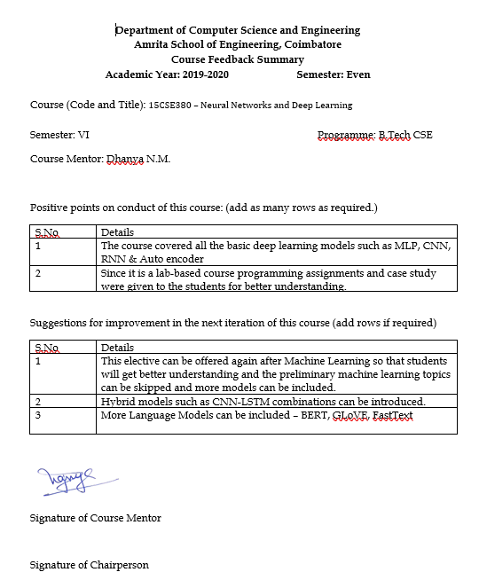

Slide 5
Course Objective
This course provides an introduction to deep neural network models, and surveys some of the applications of these models in areas where they have been particularly successful.
The course covers feedforward networks, convolutional networks, recurrent and recursive networks, as well as general topics such as input encoding and training techniques.

Slide 6
Syllabus
Unit 1
Perceptrons –classification -limitations of linear nets and perceptrons -multi-Layer Perceptrons (MLP)-activation functions -linear, softmax, tanh, ReLU; error functions -feed-forward networks -Backpropagation -recursive chain rule (backpropagation) -Learning weights of a logistic output -Loss functions -learning via gradient descent -optimization –momentum method; Adaptive learning rates –RmsProp -mini-batch gradient descent -bias-variance trade off, regularization -overfitting -inductive bias –regularization -drop out -generalization.
Unit 2
Probabilistic Neural Network-Hopfield Net, Boltzman machine, RBMs, Sigmoid net, Autoencoders;Conditional Random Fields-Linear chain, partition function, Markov network, Belief propagation, Training CRFs, Hidden Markov Model, Entropy.
Unit 3
Introduction to deep learning -Deep neural networks -convolutional nets –case studies using Keras/Tensorflow -neural nets for sequences -Recurrent Nets –Long-Short-Term-memory; Introduction to Deep unsupervised learning –PCA to autoencoders.
19CSE456 Neural Networks and Deep Learning L-T-P-C: 2-0-3-3
https://kirkpatrickprice.com/blog/classifying-data/

Slide 7
Course Outcome
COs | Course Outcome | Bloom’s Taxonomy Level
CO 1 | Understand the learning components of neural networks and apply standard neural network models to learning problems. | L3
CO 2 | Analyze the learning strategies of deep learning –regularization, generalization, optimization, bias and variance. | L4
CO 3 | Analyze regular deep learning models for training, testing and validation in standard datasets. | L4
CO 4 | Apply neural networks for deep learning using standard tools. | L3
CO 5 | Understand the mathematics for Deep learning. | L2
https://kirkpatrickprice.com/blog/classifying-data/

Slide 8
CO-PO Mapping
PO | PO1 | PO2 | PO3 | PO4 | PO5 | PO6 | PO7 | PO8 | PO9 | PO10 | PO11 | PO12 | PSO1 | PSO2
CO
CO1 | 3 | 2 | 2 | 3 |  |  |  |  |  |  |  |  | 3 | 2
CO2 | 3 | 2 | 3 | 2 | 2 |  |  |  |  |  |  |  | 3 | 2
CO3 | 3 | 2 | 3 | 2 | 3 |  |  |  |  |  |  |  | 3 | 2
CO4 | 3 | 1 | 2 | 1 | 2 |  |  |  |  |  |  |  | 3 | 2
CO5 | 3 | 1 | 2 | 1 |  |  |  |  |  |  |  |  | 3 | 2
https://kirkpatrickprice.com/blog/classifying-data/

Slide 9
Evaluation Pattern
70-30
Component | Assessments |  | Marks
Internal [70] | Midterm ( Periodical 1 + Periodical 2) |  | 20 (Online: 10 + Viva10)
 | CA(Theory) | Quiz(4Quiz*2.5) | 10
 | CA(Lab) | Eval1 -10 | 40
 |  | Case Study R1-10
 |  | Eval2 -10
 |  | Case Study R2-10
External [30] | End semester |  | 30 (10 +20)
https://kirkpatrickprice.com/blog/classifying-data/

Slide 10
LAB
LAB SESSIONS | TOPICS | KEYWORDS | OBJECTIVE | REMARKS | CO | Roughly 14-15 labs
LAB1 | Perceptron | Python, Numpy, Scipy, Pandas, and Matplotlib library | To implement the libraries necessary for ML in python | PRACTICE | CO2
LAB2 | Python for Machine Learning | Python, Numpy, Scipy, Pandas, and Matplotlib library | To implement the libraries necessary for ML in python | PRACTICE | CO2
LAB3 | Data Preprocessing and Data Visualization in Python – Practice |  |  |  | CO2
LAB4 | Eval 1 [August First/Second week] |  |  |  |  | 10 Marks
LAB5 | Regression models – Practice |  |  |  | CO2
LAB6 | PROJECT REVIEW 1 Problem Definition, Dataset selection, Exploratory Data analysis and feature engineering [August Last week/ September first week] |  |  |  |  | 10 Marks
LAB7 | Decision Tree, Random forest, interpreting results – Practice |  |  |  | CO2
LAB8 | KNN, Naive Bayes – Practice |  |  |  | CO2
LAB9 | Eval 2 [September Third/last week] |  |  |  |  | 10 Marks
LAB10 | SVM – Practice |  |  |  | CO2
LAB 11 | Perceptron – Practice |  |  |  |  | 5 Marks
LAB 12 | PCA – Practice |  |  |  | CO2
LAB 13 | Clustering – Practice |  |  |  | CO2
LAB14 | Eval 3 [October Last week] |  |  |  |  | 10 Marks
LAB 15 | PROJECT REVIEW 2 Model selection, implementation and comparison [ November first/second week] |  |  |  |  | 20 Marks
https://kirkpatrickprice.com/blog/classifying-data/

Slide 11
PROJECT
Identified 4 project domains aligned to the subject handling faculty research interest
Dr. C.Selvi- Recommender Systems and IR
Dr. Manu Madhavan- NLP, Bio informatics
Dr. M. Anbazhagan - Recommender Systems and NLP
Dr.Sikha O K- Computer vision and Image processing
https://kirkpatrickprice.com/blog/classifying-data/

Slide 12
Text Books
Ian Goodfellow, Yoshua Bengio and Aaron Courville. Deep Learning, MIT Press, Second Edition; 2016: https://www.deeplearningbook.org/
Duda, R.O., Hart, P.E., and Stork, D.G. Pattern Classification. Wiley-Interscience. Second Edition;2001. https://www.academia.edu/33126492/Pattern_Classification_by_Richard_O_Duda_David_G_Stork_Peter_E_Hart
Theodoridis, S. and Koutroumbas, K. Pattern Recognition. Fourth Edition. Academic Press;2008.
Russell, S. and Norvig, N. Artificial Intelligence: A Modern Approach. Prentice Hall Series in Artificial Intelligence;2003. https://cs.calvin.edu/courses/cs/344/kvlinden/resources/AIMA-3rd-edition.pdf
Bishop, C. M. Neural Networks for Pattern Recognition. Oxford University Press;1995.
Hastie, T., Tibshirani, R. and Friedman, J. The Elements of Statistical Learning. Springer;2001.
Koller, D. and Friedman, N. Probabilistic Graphical Models. MIT Press;2009.
Reference(s)

Slide 13


Tools
Google Colab/ Anaconda
Kaggle Contest

Slide 14

What To Do Next??
Brush up BASIC PYTHON
Explore Google Colab/ Kaggle/ Anaconda

Slide 15
Happy learning Thank you

